Slide 1
INTOSAI
WGEA
Working Group on Environmental Auditing

Slide 2
^
INTOSAI WGEA
PROGRESS REPORT
INTOSAI
Working Group
On Environmental
Auditing
The 11th INTOSAI KSC MEETING
12 – 14 JUNE 2019
PAMPANGA, PHILIPPINES

Slide 3
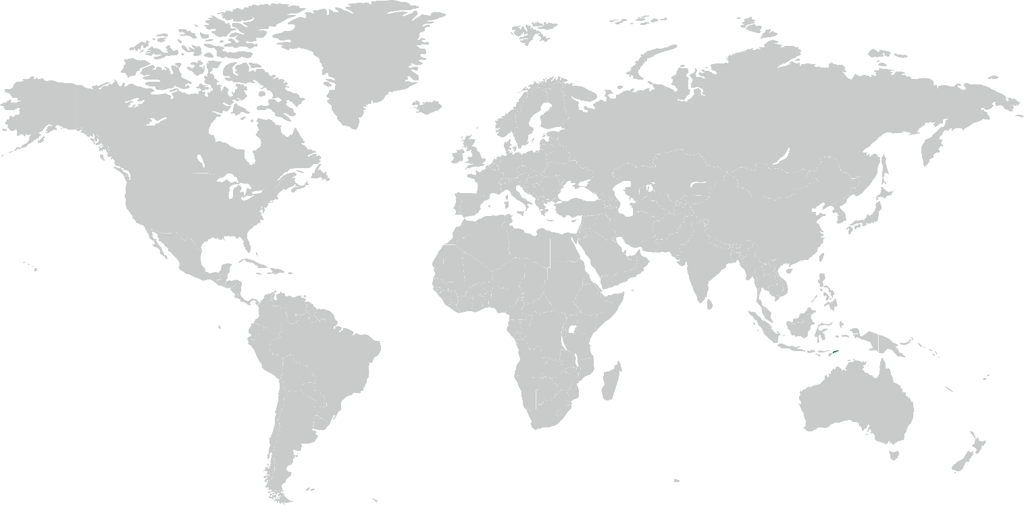
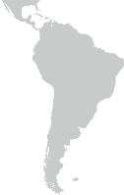
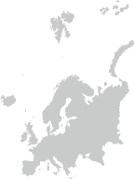
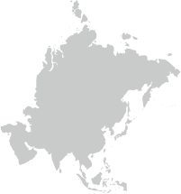
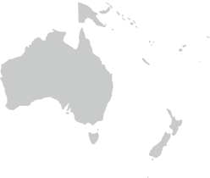
WGEA MEMBERSHIP
77
WGEA Members
WGEA Steering Committee Members
16
Brazil, Cameroon, Canada, China, Czech Republic, European Court of Auditors (ECA), Estonia, India, Indonesia, Kuwait, Lesotho, Morocco, New Zealand, Pakistan, Philippines, United States
Regional WGEA
Coordinators
ACAG/PASAI | New Zealand
ASOSAI | China
ARABOSAI | Kuwait
AFROSAI | Cameroon
EUROSAI | Estonia
OLACEFS | Brazil
OLACEFS
EUROSAI
AFROSAI
ARABOSAI
ASOSAI
ACAG/PASAI

Slide 4
WORK PLAN 2017-2019
1
GOAL 1
Up-date existing and develop new guidance materials available to SAIs, conduct research studies on emerging topics in environmental auditing
2
GOAL 2
Facilitate concurrent, joint, and coordinated audits
3
GOAL 3
Enhance information dissemination, exchange, and training
4
GOAL 4
Increase cooperation between the WGEA, international organizations and other INTOSAI bodies

Slide 5
Draft
Project Plan
April 2017
Comments from
SC members
April – May 2017
Approval of Project Plan
Sept 2017
Final version Project Plan
Oct 2017
1
2
3
4
Exposure to INTOSAI Community
March- April 2019
SC members approval on the final draft
Sept 2018
Elaborated Table of Contents
Dec 2017
MILESTONES
Draft output
July 2018
8
7
6
5
Endorsement (WGEA Assembly meeting)
August 2019
QA process,
lay outing
June – July 2019
Final version
May 2019
XXIII INCOSAI
September 2019
9
10
11
12

Slide 6
GOAL 1
GUIDANCE MATERIALS
Climate Change
Agriculture and Food Production
Land Organization and soil quality management
SDGs – through environmental auditing
Visibility of environmental auditing
Environmental Health
Waste Water
Greening Cities
RESEARCH PAPERS

Slide 7
GOAL 2
Encourage regional Cooperative Audits
Encourage other Cooperative Projects in Regional WGEA

Slide 8
GOAL 3
Assembly Meetings, Regional Annual Meetings
Training on Environmental Auditing
Develop new
Training Tools
Publish
Greenlines
9th Environmental Survey
Audit report collection

Slide 9
GOAL 4
Cooperation with the CBD Secretariat (Convention on Biological Diversity)
Auditing Biodiversity: Guidance for Supreme Audit Institutions
Continuous cooperation with the UNEP, UNDESA
Establishing new partnerships

Slide 10
QA LEVEL
01
Climate Change: Strengthen resilience and adaptive capacity to climate-related hazards and natural disasters in all countries
Auditing Agriculture and Food Production: Guidance for SAIs
QA LEVEL 3
02
Update the INTOSAI WGEA 2007 Guidance Material on Auditing Biodiversity
GUIDANCE
Auditing Land organization and soil quality management –
Combating desertification: Guidance for SAIs
03
Delivering the 2030 Agenda (Sustainable Development Goals) through Environmental Auditing
05
04

Slide 11
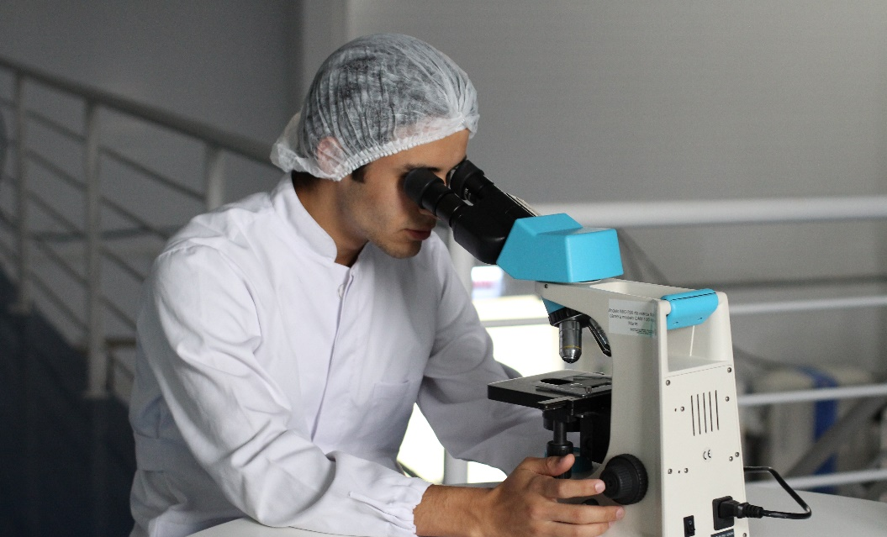
QA LEVEL 3
RESEARCH PROJECTS
TRAINING TOOLS
Visibility on Environmental Auditing (Communication)
Environmental Health (focus on Air Pollution)
Greening Cities
Water Sanitation (Waste Water)
E-learning Course (MOOC) on waste
Training tools on greening the SAIs
Training Tool on: Environmental Data: Resources and Option for SAIs

Slide 12
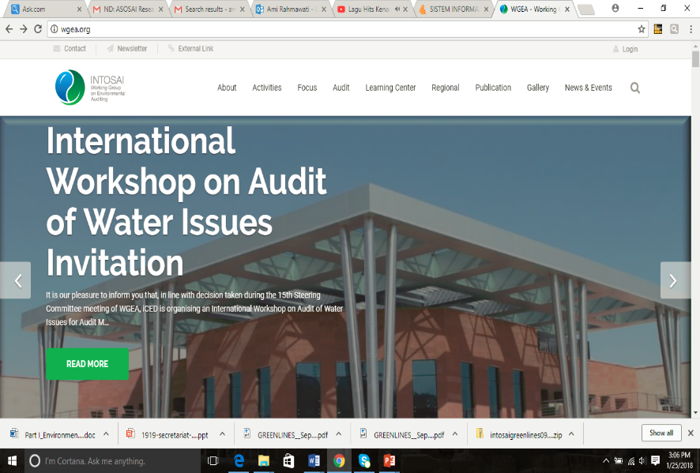
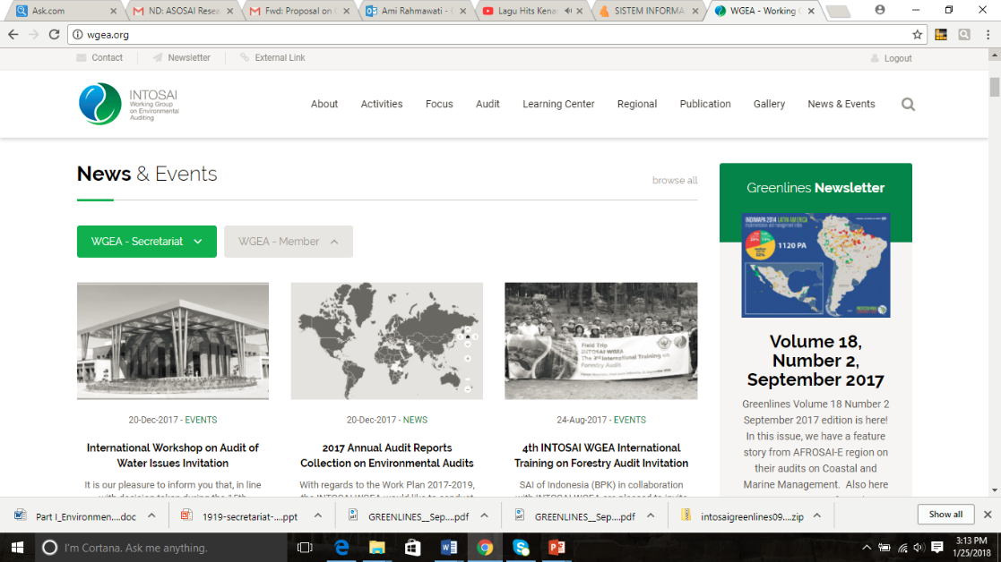
More information,
please click www.wgea.org

